Slide 1

Post Secondary Exploration:
Computer Science

Slide 2
Rundown
Local: Laurier University
In Ontario: University of Toronto
In Canada: University of British Columbia
International: Carnegie Mellon University
Careers from a Comp Sci Degree

Slide 3

Laurier University
Local Option, Waterloo ON

Slide 4
Program: Computer Science (BSc)
Duration: four years
Solve problems, innovate and make life better through technology. From applied cryptography to mobile computing, computer science will help you develop robust algorithm analysis and design skills in procedural, object-oriented and low-level languages. Gain the hands-on experience that is key to understanding computing fundamentals.
Minimum admission range: high 70s.
Competitive admission range based on last year’s admitted students: mid 80s.
English at 60%.
Advanced Functions at 60%.
One of Calculus and Vectors, Chemistry or Physics at 60%.
Prerequisites:
One of ENG4U, ETS4U, EWC4U or EAE4U at 60%
MHF4U at 60%
One of MCV4U, SCH4U or SPH4U at 60%
Website: Future Students | Wilfrid Laurier University (wlu.ca)

Slide 5
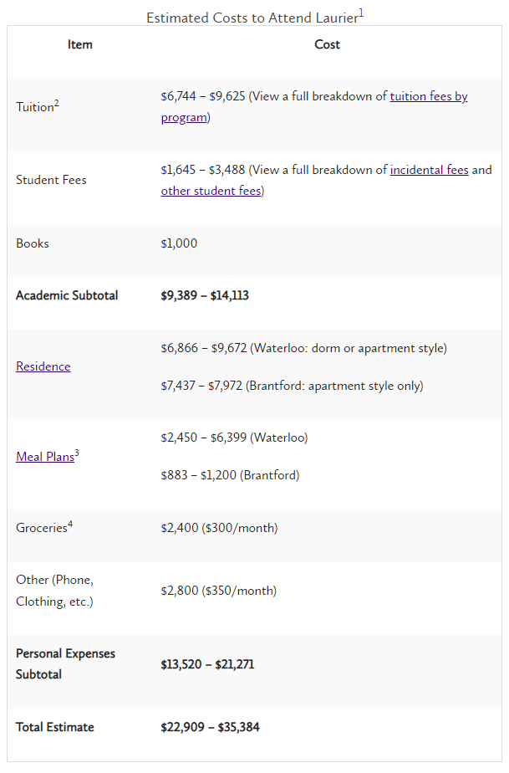
Costs to attend

Slide 6

University of Toronto
Provincial Option, Toronto ON
Also known as UofT

Slide 7
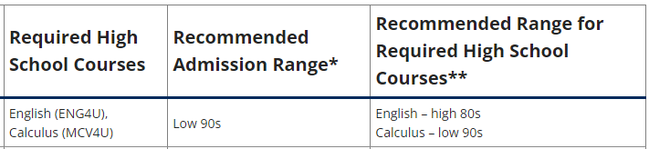
Program: Computer Science
Duration: four years
Students in computer science will learn how to design software, develop computer applications such as databases and graphics and investigate mathematical problems. They will train to meet an increasing demand for graduates with scientific knowledge and creative skills to excel in the industry. A computer science degree will introduce students to tomorrow's technological world.
General Admission Requirements:
Ontario Secondary School Diploma (OSSD)
At least six (6) Grade 12 University (U) or University/College (M) courses
One of the above six courses must be ENG4U
Website: Home - Future Students. University of Toronto | University of Toronto (utoronto.ca)

Slide 8
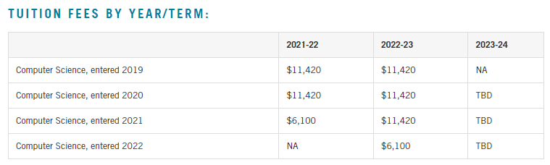
Costs to attend

Slide 9

University of British Columbia
Out of Province Option, Vancouver BC
Also known as UBC

Slide 10
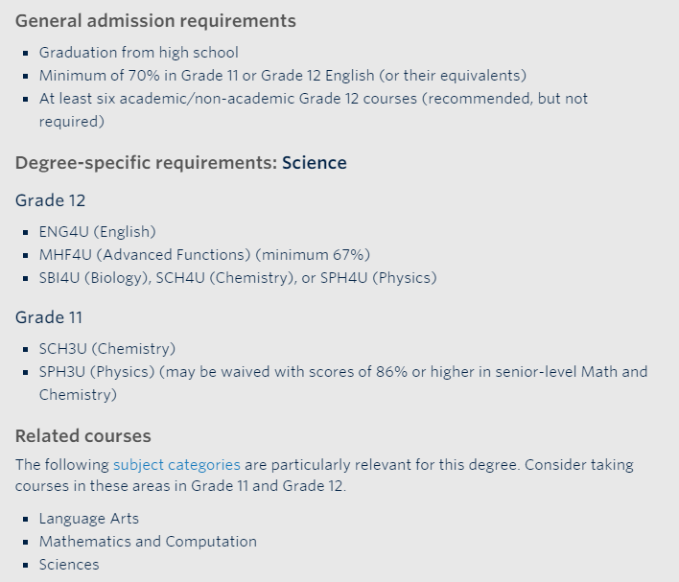
Program: Computer Science (BSc)
Duration: four years
Learn how to use and improve computers while you explore topics such as databases and operating systems, software engineering, security, web development, and numerical methodology. Computer Science gives you a thorough grounding in computer software design, and a broad choice of other studies in computing. You’ll take courses like “Machine Learning and Data Mining,” “Parallel Computation,” and “Advanced Algorithms Design and Analysis.”
Website: Computer Science at UBC's Vancouver campus | UBC Undergraduate Programs and Admissions

Slide 11
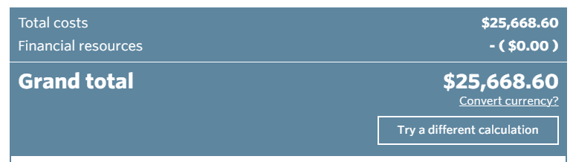
First year costs

Slide 12
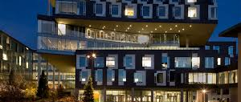
Carnegie Mellon University
International Option, Pittsburg PA, USA
Also known as CMU

Slide 13
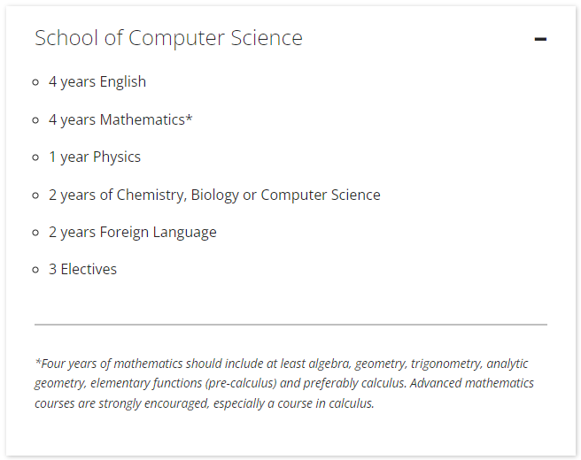
Program: B.S. in Computer Science
Carnegie Mellon's undergraduate computer science major combines a solid core curriculum with a required minor, providing flexibility to explore other subjects. Students gain practical and theoretical skills through project-oriented courses and mathematics training. CMU stands out by offering undergraduate research opportunities, including part-time jobs and an intensive research course. This prepares students for graduate school and culminates in a senior research honors thesis.
Website: Carnegie Mellon University Computer Science Department (cmu.edu)

Slide 14
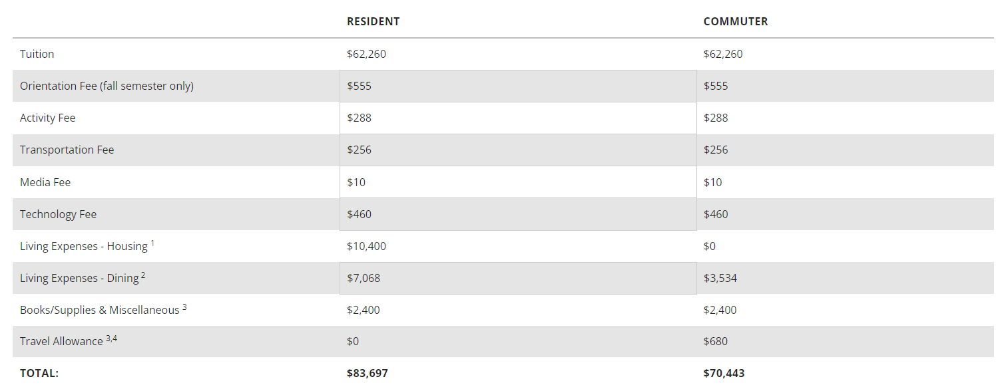
Costs to attend

Slide 15
Careers
From a Computer Science Degree

Slide 16
Opportunities include but are not limited to:
Software Developer/Engineer: Designing, developing, and maintaining software applications and systems.
Data Scientist: Analyzing large datasets to extract insights and make data-driven decisions.
Cybersecurity Analyst: Protecting computer systems and networks from security threats and implementing measures for data protection.
Artificial Intelligence/Machine Learning Engineer: Building AI models and algorithms to develop intelligent systems and technologies.
Web Developer: Creating and maintaining websites and web applications.
Systems Analyst: Evaluating and improving computer systems and processes to enhance efficiency and productivity.
Database Administrator: Managing and organizing databases to ensure data integrity and efficient access.
Network Administrator: Configuring and maintaining computer networks for smooth communication and data transfer.
IT Project Manager: Leading and managing technology projects, ensuring timely delivery and successful implementation.
Software Quality Assurance Engineer: Testing and ensuring the quality and reliability of software products.
there are many more career opportunities available in the field of computer science.

Slide 17
Thanks for watching

